Slide 1
Automated screening for detection and
Assessment of glaucoma progression using
fundus images
TEAM NAME : Enigma
NAME OF THE PRESENTER :
NAMES OF TEAM MEMBERS : Sathish kumar M
Karan V
Vishal L
Thiruvengadam S
Rajalakshmanan S

Slide 2
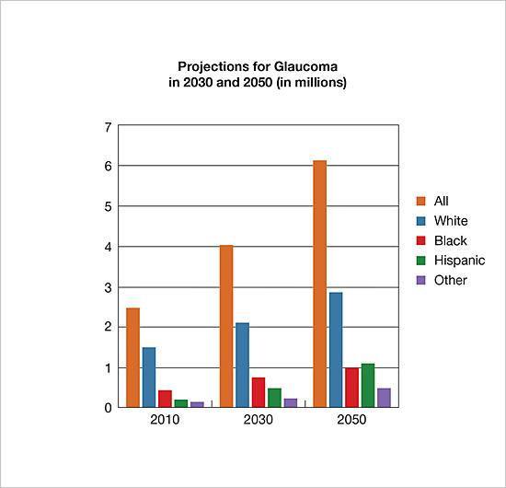
PROBLEM STATEMENT:
An early detection of glaucoma is particularly significant since it allows timely treatment to prevent major visual field loss and prolongs the effective years of usable vision. The diagnosis of glaucoma can be done through measurement of CDR (cup- to-disc ratio) and OCT images. Currently, CDR evaluation is manually performed by trained ophthalmologists. So it is subjective and in case of OCT devices, currently using techniques are not accurate. Thus, this work proposes an intuitive, efficient, accurate and objective method for automatically classifying digital fundus images and OCT images into either normal or glaucomatous types in order to facilitate ophthalmologists.
Source : National Eye institute, US

Slide 3
PRODUCT / SOLUTION / SERVICE:
We are working on a ML Model that will be able to classify these images into glaucoma or normal , then also classify it in to the its types of glaucoma.
Our project is to develop a web app that will help the people who are in Rural areas to diagnose Glaucoma with a smartphone fundus imaging.
The challenge for us is that the smart phone fundus imaging has more noise. We are also working on different ways of reducing the noise in the fundus imaging. Since Glaucoma is a progressive disease that gets worse on time we are looking up the possibility of detecting glaucoma based on the regular eye tests .
This can prevent many people from entering the more serious stages of Glaucoma Thus preventing permanent blindness.

Slide 4
BUSINESS MODEL – MARKET SIZE AND POTENTIAL:
This is an emerging market and a new technologies will make the process amore efficient and reduce the costs of operations greatly. We see that this is the third largest market after Cancer and Heart Diseases (Excluding COVID-19).
Most of the people are afraid of glaucoma and its eternal blindness, Since it cannot be reversed or cured yet.
On the basis of the available data, we estimate that there are approximately 11.2 million persons aged 40 years and older with glaucoma in India.

Slide 5
BUSINESS MODEL – TARGET CUSTOMER:
We are currently building a mobile app that can classify images from glaucoma or normal from any Fundus Imaging (smartphone or Regular Fundus Imaging). Since running the Machine Learning Model on we requires a powerful server that cannot be obtained for free, There might be a small fee to cover the operational costs of the model, we are also planning to build a Lite version that does not require any server connection .
(or)
There might be a monthly fee for those who use our model regularly. (especially in places like for profit hospitals)
We are happy to let the model to be available to the public to use it for free until we have enough backing for it.

Slide 6
SOCIO-ECONOMIC IMPACT:
We aim to make the diagnosis or at least a warning about the onset of glaucoma by making it more accessible to the Rural region where the heavy equipment are difficult to transport, Our app will help these causes by delivering the diagnosis cheaper and faster.

Slide 7
ESTIMATED COST OF PRODUCT: TIME TO MARKET:
Serverless Compute : $15 or Rs 1117 per month
Database and storage : $ 30 or Rs 2300 per month
CDN : $2 or Rs. 150 per month
All these calculations are under the assumption of 10K requests per month
TIME TO MARKET:
Time to Acquire Data + 1 month
Expected time to market 3 months

Slide 8
FUTURE DIRECTION:
Augmented Reality based Visual field test with dynamic eye tracking
Lite version of the app for very rural areas
Handy apparatus with Lens kit

